Slide 1

UNLOCKING THE SECRETS OF THE SUN

Slide 2
These more detailed observations will unravel basic puzzles of solar physics and may help to more efficiently predict harmful solar flares aimed at Earth. Called coronal mass ejections (EMC), these dangerous clouds of extremely energetic particles produce sparkling auroras that can fascinate even in mid-latitude skies, but can also knock out communication satellites, power grids and be lethal to astronauts.

Slide 3
The purpose of Instagram is to inform users of how valuable and impactful are the data provided by the Parker Solar Probe

Slide 4
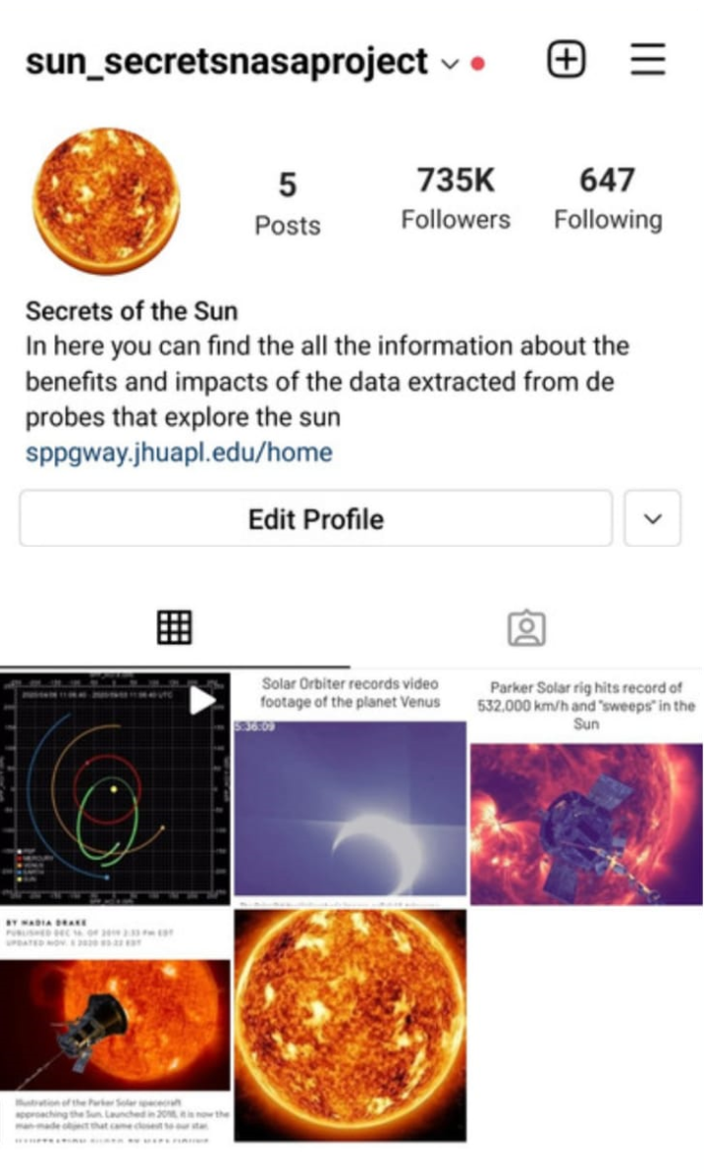
Here is the Instagram created

Slide 5
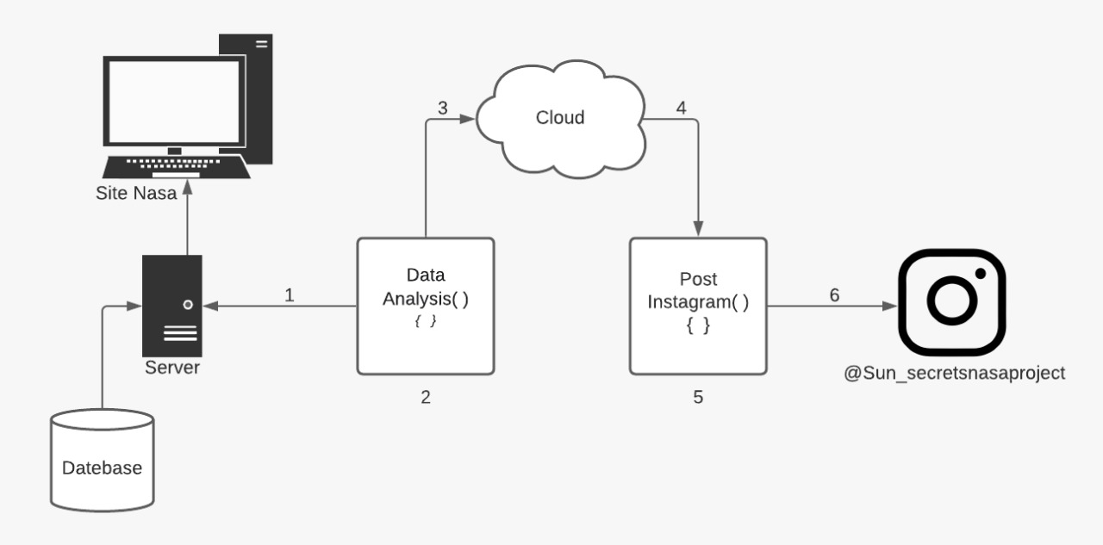

Slide 6
1st - is responsible for collecting raw data from NASA servers; 2nd - responsible for filtering the necessary information; 3rd - sending to the cloud database; 4th - data capture by the system; 5th - translation and formation of content for posting and 6th - posting on Instagram automatically

Slide 7
Above, we present a diagram regarding the process of how the separation of information will work, through a program that will have the function of filtering all technical languages ​​on the NASA website, so that it is interpreted objectively for any and all audiences, making with the population having access to knowledge of a subject, which the way it is treated is not understood.

